Slide 1
Requirement engineering
Radócz Balázs
Balazs_Radocz@epam.com
<EPAM Systems>
CONFIDENTIAL | © 2025 EPAM Systems, Inc.

Slide 2
Requirements

Slide 3
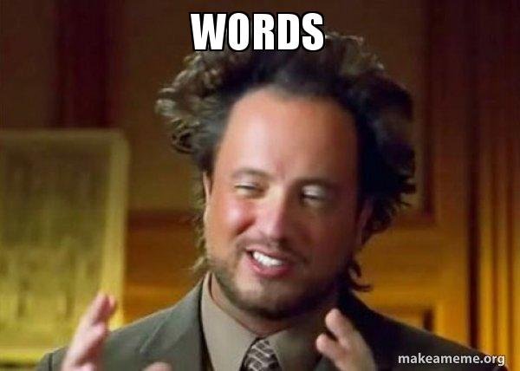
Requirements
Definition of Requirement
A condition or capability needed by a user to solve a problem or achieve an objective.
A condition or capability that must be met or possessed by a system or system component to satisfy a contract standard specification, or other formally imposed documents.
A documented representation of a condition or capability as in above.
CONFIDENTIAL | © 2025 EPAM Systems, Inc.

Slide 4
Requirements
Requirement – simplified version
A condition or capability needed by a user to solve a problem or achieve an objective. -> What WE must do and why?
A condition or capability that must be met or possessed by a system or system component to satisfy a contract standard specification, or other formally imposed documents. -> What the SYSTEM must do or have?
A documented representation of a condition or capability as in above. -> All the written stuff, which we could refer to.
In short: A good set of requirement will define how the desired objective will be done, and what we expect from it under all circumstances.
CONFIDENTIAL | © 2025 EPAM Systems, Inc.

Slide 5
Requirements
Requirement types
Functional Requirements
  A functional requirement is a requirement concerning a result of behavior that shall be provided by a function of the system
Quality Requirements
  A quality requirement is a requirement that pertains to a quality concern that is not covered by functional requirements
  Performance, availability, dependability, scalability, portability (non-functional requirements)
Constraints
  A constraint is a requirement that limits the solution space beyond what is necessary for meeting the given functional and quality requirements
  Deadline, Web based solutions only, etc.
CONFIDENTIAL | © 2025 EPAM Systems, Inc.

Slide 6
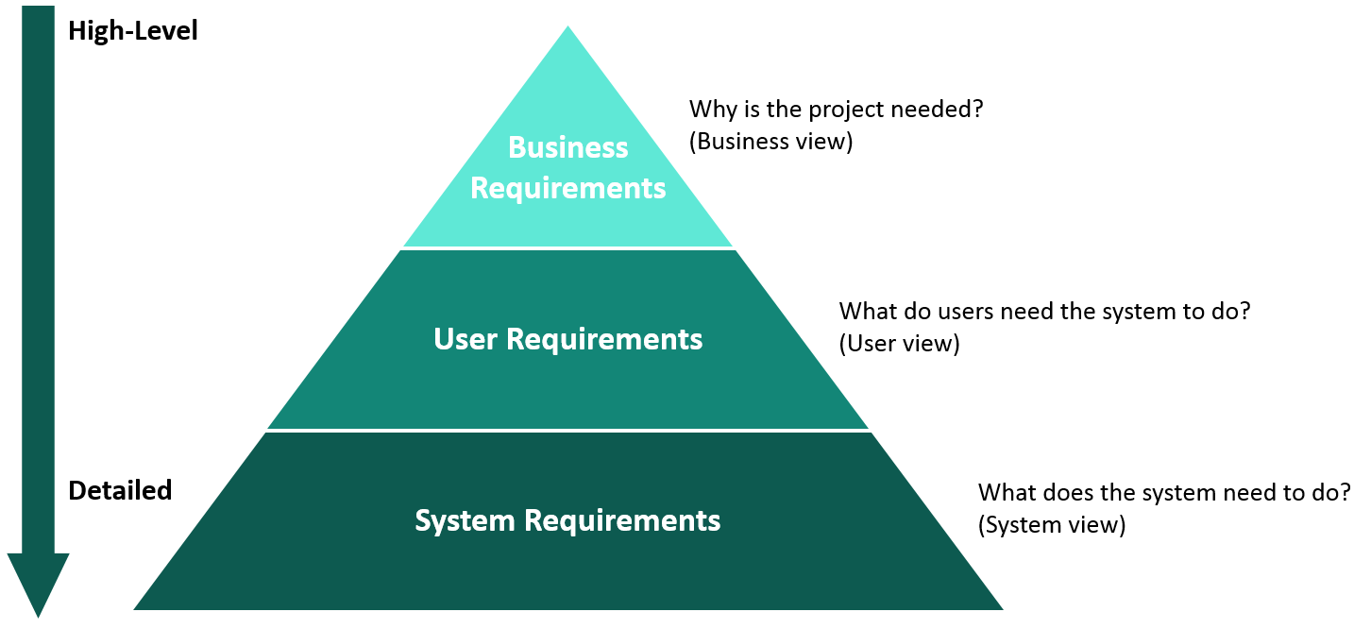
Requirements
Requirement types
CONFIDENTIAL | © 2025 EPAM Systems, Inc.

Slide 7
Fundamentals of Requirements Engineering

Slide 8
Requirements Engineering
Requirement types
Requirements engineering is a systematic and disciplined approach to the specification and management of requirements with the following goals:
- Knowing the relevant requirements, achieving a consensus among the stakeholders about these requirements, documenting them according to given standards, and manage them systematically.
Understanding and documenting the stakeholders’ desires and needs, they specifying and managing requirements to minimize the risk of delivering a system that does not meet the stakeholders’ desire and needs
CONFIDENTIAL | © 2025 EPAM Systems, Inc.

Slide 9

Requirements Engineering
Why we need Requirements engineering?
Communication of requirements improved
60 % of errors originate from requirements engineering phase
Bad, missing,
  During programing 20 times more expensive
  During Acceptance Testing 100 times
Reasons for not dealing with requirements:
  Self evident, no need to be stated explicitly
CONFIDENTIAL | © 2025 EPAM Systems, Inc.

Slide 10

Requirements Engineering
Four Core Activities of Requirements Engineering
Elicitation (with other words: obtaining information)
Documentation
Validation and negotiation
Management
CONFIDENTIAL | © 2025 EPAM Systems, Inc.

Slide 11
Requirements Engineering
Requirements Engineer, the Person
Analytic thinking
Empathy
Communication skills
Conflict resolution skills
Moderation skills
Self-confidence
Persuasiveness
CONFIDENTIAL | © 2025 EPAM Systems, Inc.

Slide 12

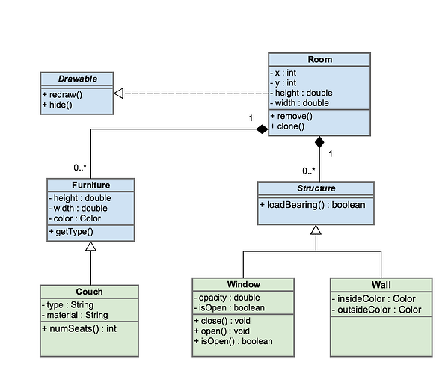
Requirements Engineering
Communication
Common language
  Natural
  UML
CONFIDENTIAL | © 2025 EPAM Systems, Inc.

Slide 13
Eliciting Requirements

Slide 14
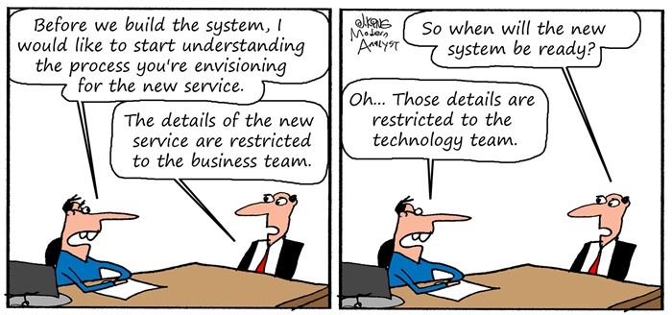
Eliciting Requirements
How should we imagine it?
Requirements do not simply exist; they have to be elicited!
CONFIDENTIAL | © 2025 EPAM Systems, Inc.

Slide 15
Requirements Engineering
Requirement sources
Stakeholders
  People or organizations
  Examples: users, operators, developers, architects, customers, testers, etc.
Documents
  Legal documents, standards, error reports, etc.
Systems in operation
  Legacy or predecessor systems
  Competing systems
CONFIDENTIAL | © 2025 EPAM Systems, Inc.

Slide 16
Requirements Engineering
Kano Model
Dissatisfiers
  Properties that are self-evident and taken for granted
Satisfiers
  Explicitly demanded system properties
Delighters
  System properties that the stakeholders does not know or expect and discovers only while using the system
CONFIDENTIAL | © 2025 EPAM Systems, Inc.

Slide 17
Requirements Engineering
Techniques I.
Survey Techniques
  Precise but time consuming
  Interviews, Questionnaires are forms of it
Creativity Techniques
  Sometimes not precise enough
  Brainstorming, Six Thinking Hats, Analogy
Document-centric Techniques
  Should be combined with other techniques
  Good for legacy systems
  System archaeology (from doc. or code), Perspective-based reading, Reuse
CONFIDENTIAL | © 2025 EPAM Systems, Inc.

Slide 18
Requirements Engineering
Techniques II.
Observation Techniques
  It shows the “as is” rather “to be”
  Not suitable to develop a new process
  Field observation, apprenticing
Support Techniques
  Addition to techniques above
  Mind mapping, workshops, audio and video records, use care modeling, prototypes
CONFIDENTIAL | © 2025 EPAM Systems, Inc.

Slide 19
Requirements Engineering
The requirements engineer
Speaks the language of the stakeholders
Becomes thoroughly familiar with the application domain
Creates the requirements document
Is bale to get work results across
Maintains a respectful relationship with any stakeholders
Presents her ideas and alternatives as well as their realization
Allows stakeholders to demand properties that makes the system user-friendly and simple
Ensures that the system satisfies the functional and qualitative demands of the stakeholders
CONFIDENTIAL | © 2025 EPAM Systems, Inc.

Slide 20
Requirements Engineering
The stakeholder
Introduce the requirements engineer to the application domain
Supply the requirements engineer with requirements
Documents requirements assiduously
Make timely decisions
Respects the requirements engineer’s estimates of costs and feasibility
Prioritize requirements
Inspect the requirements that the requirements engineer documents, such as prototypes
Communicate changes in requirements immediately
Adhere to the predetermined changes process
Respect the requirements engineering process that has been installed
CONFIDENTIAL | © 2025 EPAM Systems, Inc.

Slide 21
Documenting Requirements

Slide 22
Documenting Requirements
Documentation Perspectives
Data perspective
Functional perspective
Behavioral perspective
Natural language-based documentation
Conceptual modeling language-based documentation
Use case diagram
Class diagram
Activity diagram
State diagram
CONFIDENTIAL | © 2025 EPAM Systems, Inc.

Slide 23

Documenting Requirements
Natural Language, Transformational Processes
Nominalization
  Process is converted into an event
Nouns without reference index
  Incompletely specified nouns
Universal quantifiers
  Specified behavior or property does not apply to all objects
Incompletely specified conditions
Incompletely specified process verbs
CONFIDENTIAL | © 2025 EPAM Systems, Inc.
Notes:
Nominalization – Folyamat főnévvé alakítva, eseményként kezelve
Nouns without reference index – Pontatlanul meghatározott főnevek
Universal quantifiers – Univerzális mennyiségjelzők (pl. „minden”, „összes”), amelyeknél a viselkedés vagy tulajdonság nem minden objektumra igaz
Incompletely specified conditions – Hiányosan meghatározott feltételek
Incompletely specified process verbs – Hiányosan meghatározott cselekvést kifejező igék
Nominalization: ha egy folyamatot csak egy főnévként említünk, de nem derül ki, ki végzi és hogyan (pl. „adatfeldolgozás történik” – de ki, mikor, hogyan?).
Pontatlan főnevek: ha azt mondjuk „a rendszer kezeli a fájlokat” – de milyen fájlokat pontosan?
Univerzális mennyiségjelzők: ha azt írjuk „minden felhasználó hozzáfér” – de tényleg mindenki? Vagy csak bizonyos csoportok?
Hiányos feltételek: ha a követelmény nem írja le, mikor, milyen körülmények között kell teljesülnie.
Hiányos igék: ha pl. „a rendszer ellenőrzi az adatokat” – de hogyan ellenőrzi? Mit néz pontosan?
Röviden: a requirement-ek dokumentálásánál a legnagyobb veszély a homályosság. Mindig pontosítani kell a „ki, mit, mikor, hogyan, milyen körülmények között” kérdésekre, különben a fejlesztők és a megrendelők mást fognak érteni ugyanazon mondat alatt.

Slide 24
Documenting Requirements
Natural Language, Transformational Processes - examples
Nominalization
  Data processing takes place
  The system automatically processes incoming data and saves it into the database within 2 seconds
Vague nouns:
  The system handles files
  The system can upload, store, and open PDF and DOCX files
Universal quantifiers:
  All users have access to the data
  Administrators and project managers can access all data, while regular users can only access their own
CONFIDENTIAL | © 2025 EPAM Systems, Inc.

Slide 25
Documenting Requirements
Natural Language, Transformational Processes - examples
Incompletely specified conditions
  The system displays an error message
  If the user enters the wrong password three times, the system displays a red warning message and blocks login for 5 minutes
Incompletely specified process verbs
  The system checks the data
  The system checks that the entered e-mail address contains an @ symbol and a valid domain name
CONFIDENTIAL | © 2025 EPAM Systems, Inc.

Slide 26
Documenting Requirements
Natural Language, Transformational Processes - examples
SHALL
<process verb>
SHOULD
[When? Under what condition?]
THE SYSTEM
<system name>
Provide <whom?> WITH THE ABILITY TO <process verb>
<object>
<additional details about the object>
WILL
BE ABLE TO <process verb>
MAY
CONFIDENTIAL | © 2025 EPAM Systems, Inc.

Slide 27
Documenting Requirements
Quality Criteria for Requirements
Agreed
Unambiguous
Necessary
Consistent
Verifiable
Feasible
Traceable
Complete
Understandable
CONFIDENTIAL | © 2025 EPAM Systems, Inc.

Slide 28
Thank you for the attention!

